Slide 1
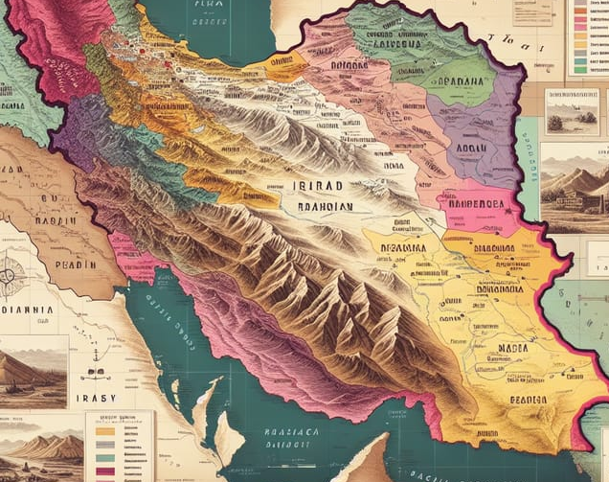
Iran's Historical Cities: A Journey Through Time
Danyal Abbasinejadfallah
10/12/2024

Slide 2
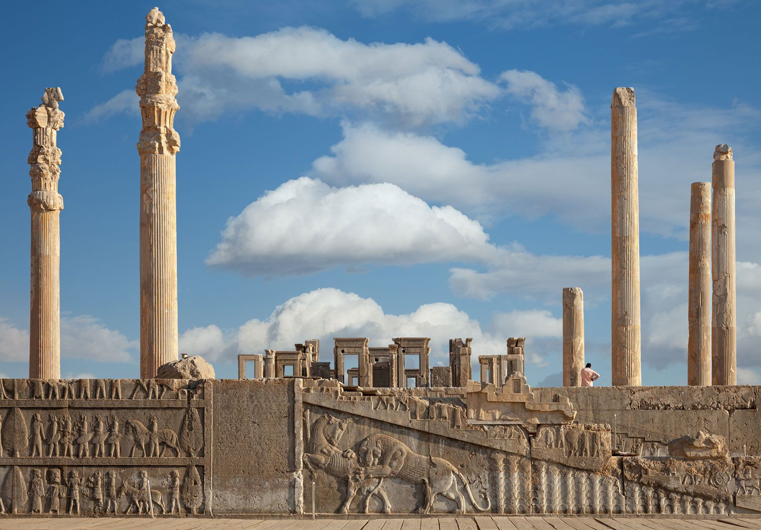
Persepolis (takht e Jamshid)
Persepolis, or "City of the Persians," was the ceremonial capital of the Achaemenid Empire, built by Darius I in 518 BCE.

Slide 3
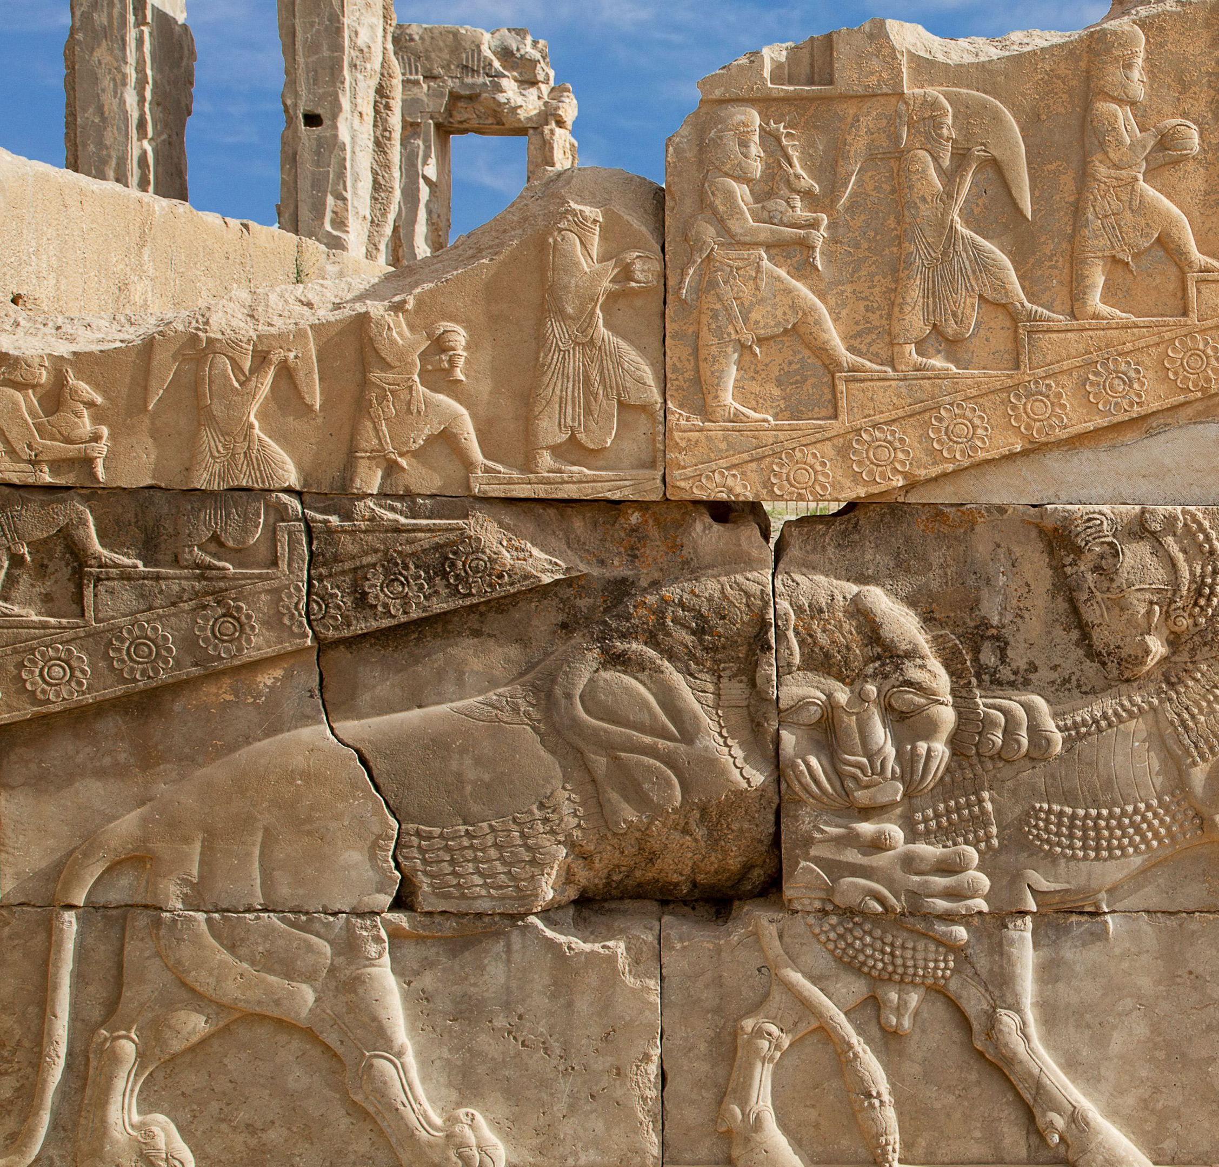
Persepolis (takht e Jamshid)
The city was used for special ceremonies, including Nowruz (Persian New Year), and hosted representatives from 23 nations, as seen in its intricate carvings. These reliefs celebrated the unity and prosperity of the empire.

Slide 4
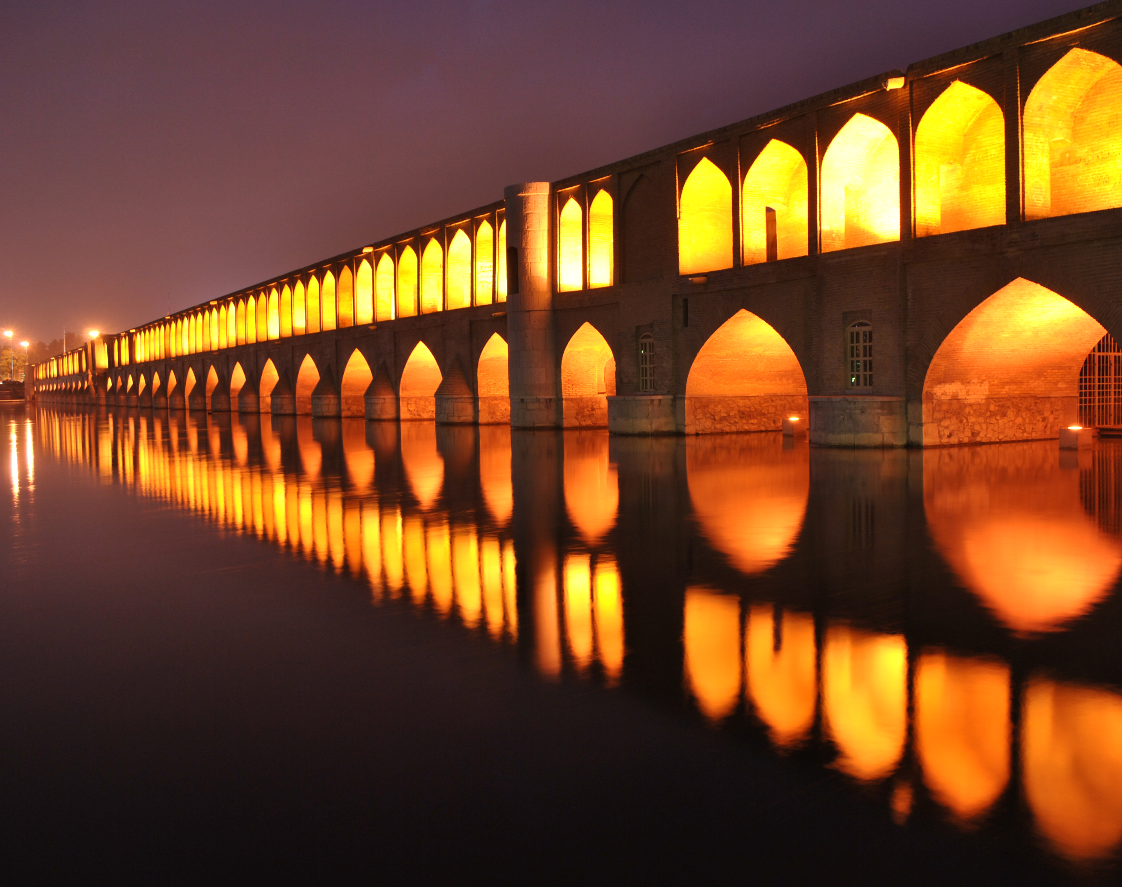
Isfahan
Isfahan, often referred to as "Half of the World", is one of Iran's most famous and historically significant cities.
The city was transformed into a center of art, culture, and commerce.

Slide 5
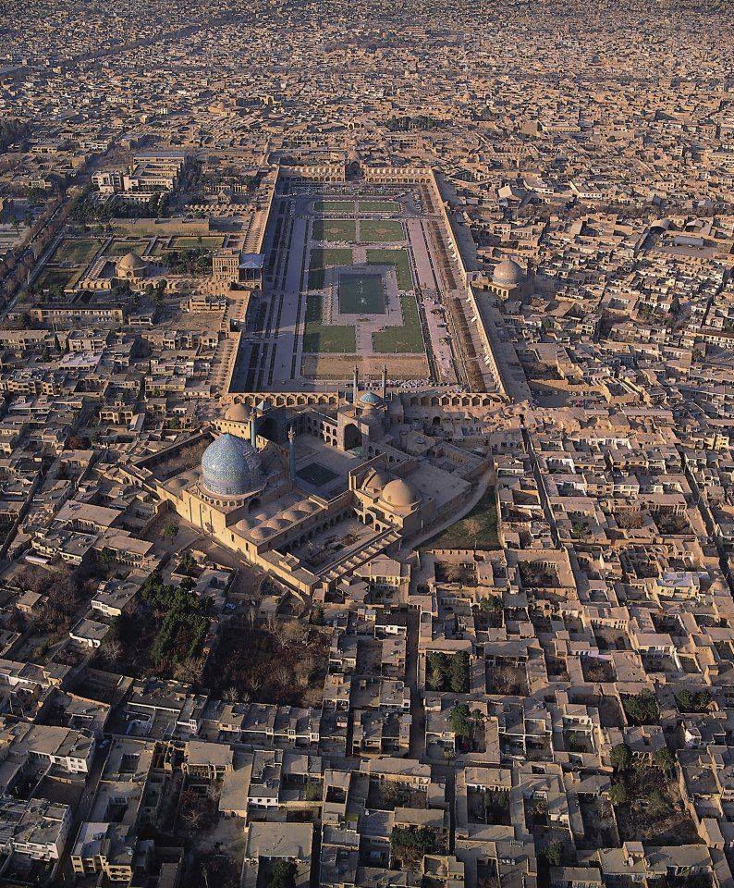
Isfahan
Naqsh-e Jahan Square is one of the most iconic and grand squares in the world. Located in Isfahan, Iran.
It was built during the Safavid era under the reign of Shah Abbas I in the early 17th century, between 1598 and 1629. The square is a symbol of the Safavid Empire's power, art, and architectural achievements.

Slide 6
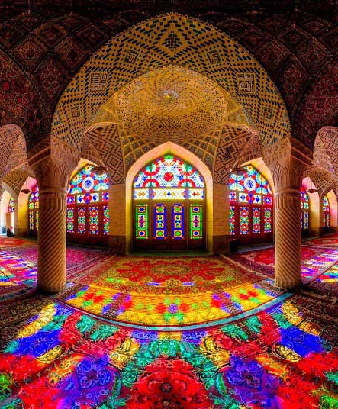
Shiraz
Shiraz is one of Iran’s most famous cities, known for its rich cultural heritage, beautiful gardens, and poetic legacy. Located in the southern part of Iran.
In Fars Province, Shiraz has a history that stretches back over 4,000 years, making it one of the oldest cities in Iran.

Slide 7
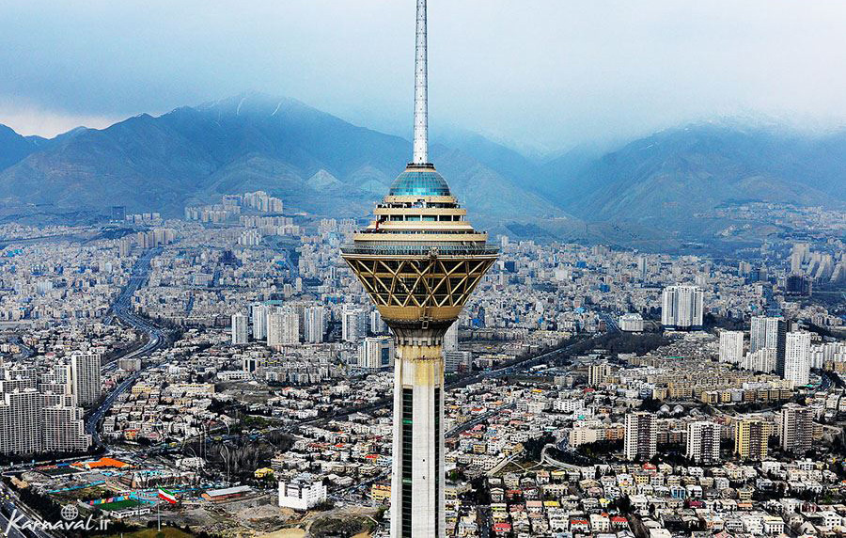
Tehran
Tehran, the capital of Iran, is the largest and most populous city in the country.
Located in the north of Iran at the foot of the Alborz Mountains, Tehran has been the political, economic, and cultural center of the country for over two centuries.

Slide 8
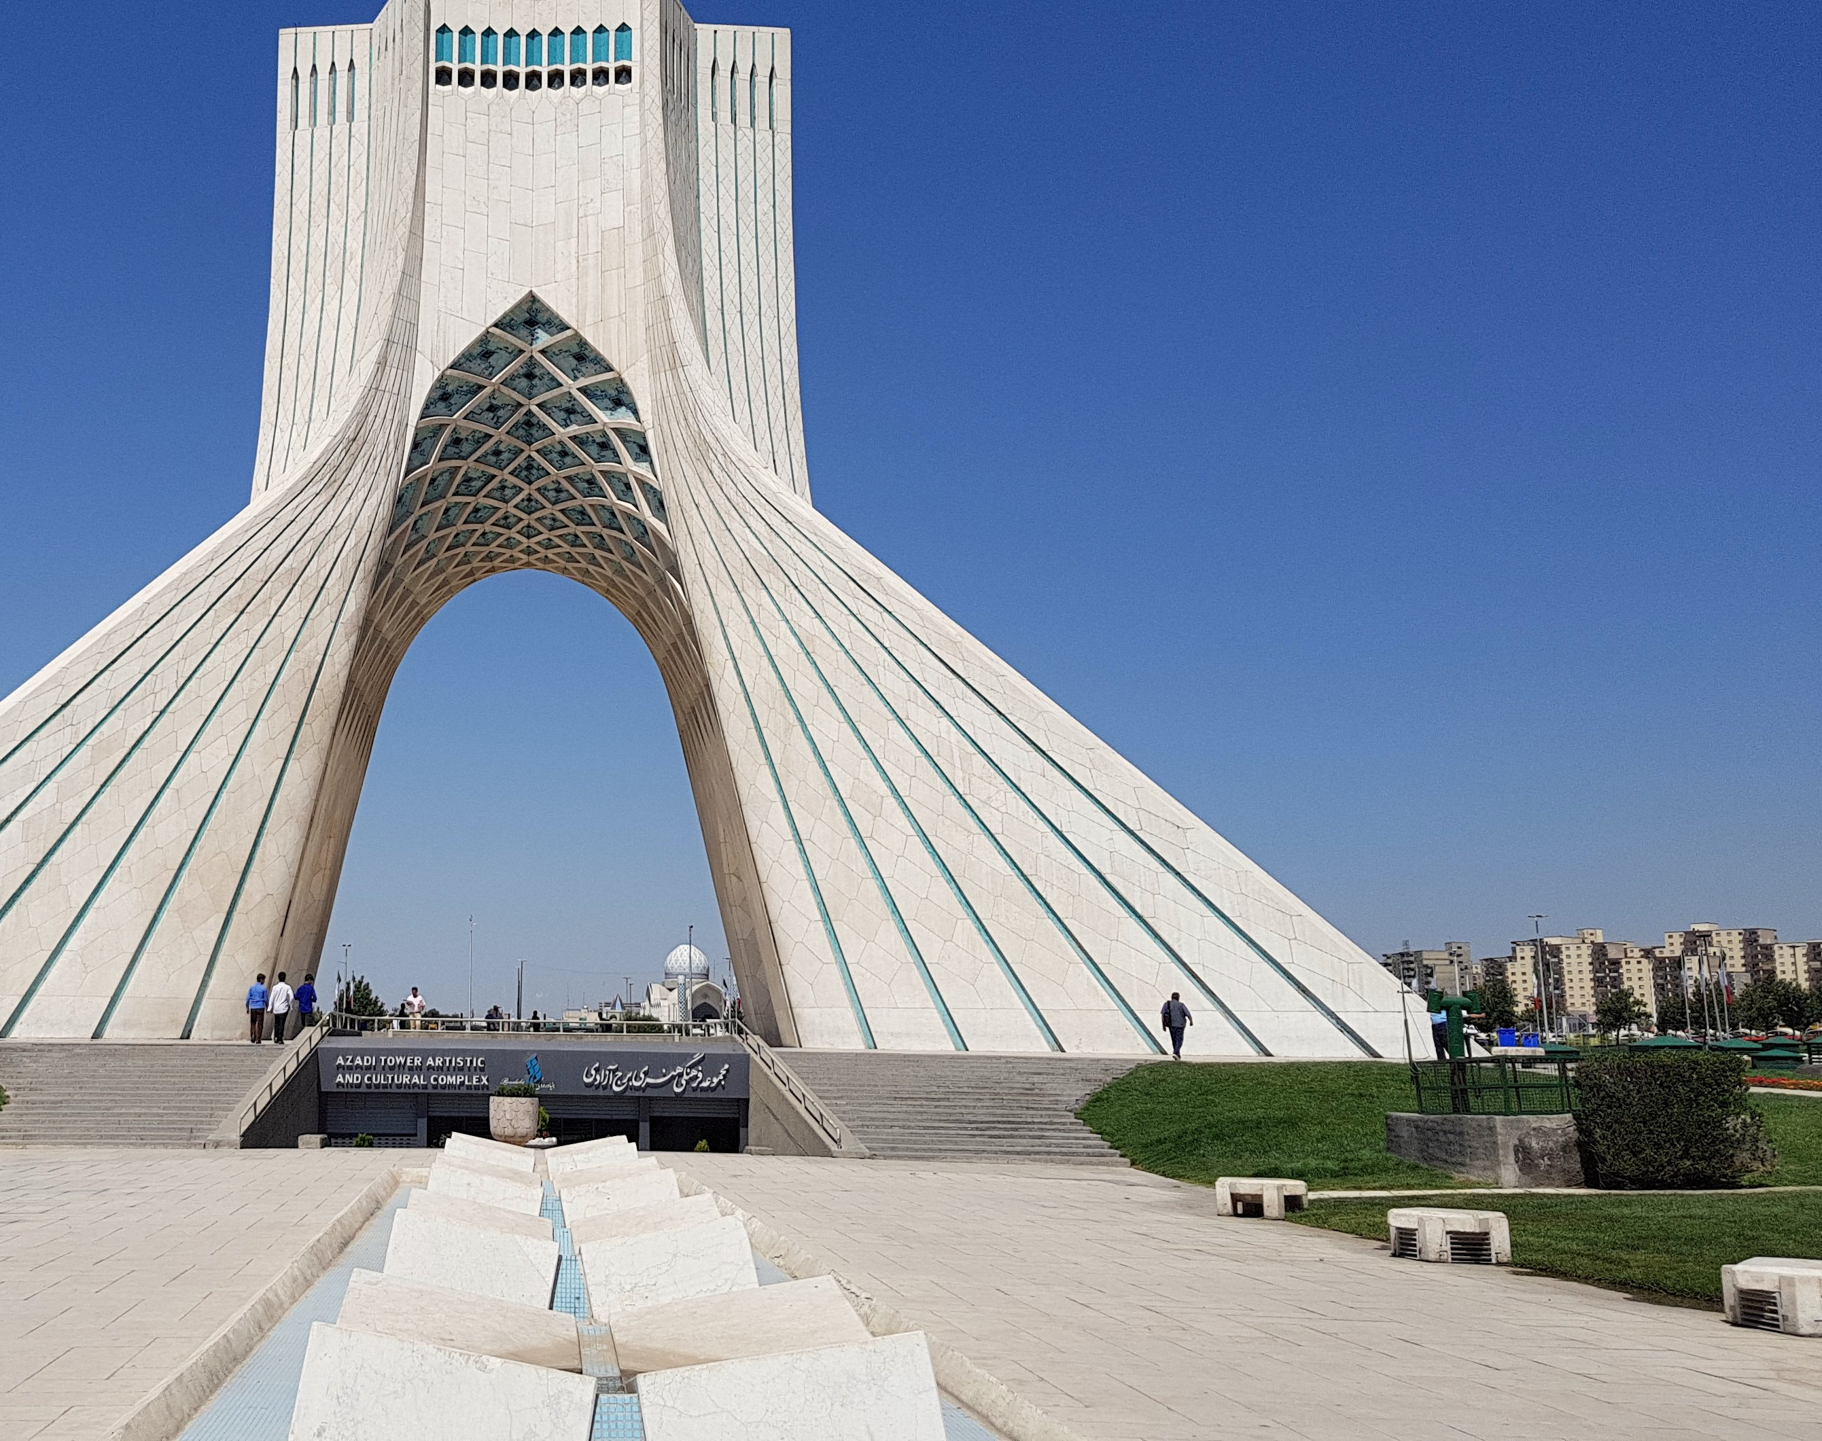
Tehran (Historical Significance)
Tehran became the capital of Iran in 1796 under the Qajar dynasty and has remained the capital ever since. Prior to that, the capital was in Isfahan and Shiraz at different points in history.
Azadi Tower (Freedom Tower): A symbol of Tehran and Iran’s modern history, built in 1971 to commemorate the 2,500th anniversary of the Persian Empire. It combines traditional Persian architecture with modern design.

